Slide 1


AIRTRACK
Mini Project
1
Airport Construction

Slide 2
Developed By
Miss. Cheke Sneha Prabhakar
Miss. Mohite Gauri Uttam
Miss. Patil Varsha Vikas
Guided by:
Asst Prof. Miss Jadhav P. S.
2
Airport Construction

Slide 3
Content
ACM ICPC Problem
Problem Statement
Objective
Introduction
Description
Input
Output
Conclusion
Reference
3
Airport Construction

Slide 4
ACM ICPC problem
ACM ICPC2017
Problem no A
Airport Construction
The tropical island nation of Piconesia is being considered as a future location for the world finals of the ACM International Collegiate Programming Contest. There is only small problem: the island is really hard to reach.
4
Airport Construction

Slide 5
Currently the fastest way to reach the island three days from the nearest airport, and uses a combination of fishing boat, oil tanker, kayak, and submarine. To make attending the ICPC World Final slightly easier and to jump-start the island’s tourism business, Piconesia is planning to built its first airport.
Airport Construction
5

Slide 6
Problem Statement :
To compute the length of the longest landing strip that can be built on the island.
Objective:
To construct the Airtrack on polygon shape island .
Airport Construction
6

Slide 7
Introduction
In our project named Airtrack we have referred ACM International Collegiate Programming Contest from said material we found various problems out of which we design the Airtrack system such way that we use maximum surface area with respect to available area.
for our project we use distance formula to calculate the maximum distance among two points .
Airport Construction
7

Slide 8
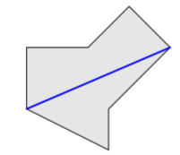
Description
Given this polygon we need to compute the length of lonest landing strip (i.e. straight line segment) that can be built on the island . The landing strip must not intersect the sea, but it may touch or run along the boundary of the island.
Airport Construction
8

Slide 9
Scope of project:-
To design Airtrack on the polygon shape island .
Airport Construction
9

Slide 10
Input
This polygon is simple, i.e. its vertices are distinct and no two edges of the polygon intersect or touch, except that consecutive edges touch at their common vertex.
In addition, no two consecutive edges are collinear.
Distance formula
distance=sqrt(pow(x1-x2)2)+pow(y1-y2)2))
Sample input | Output
3 0 2017 -2017 -2017 2017 0 | 4510.15
Airport Construction
10

Slide 11
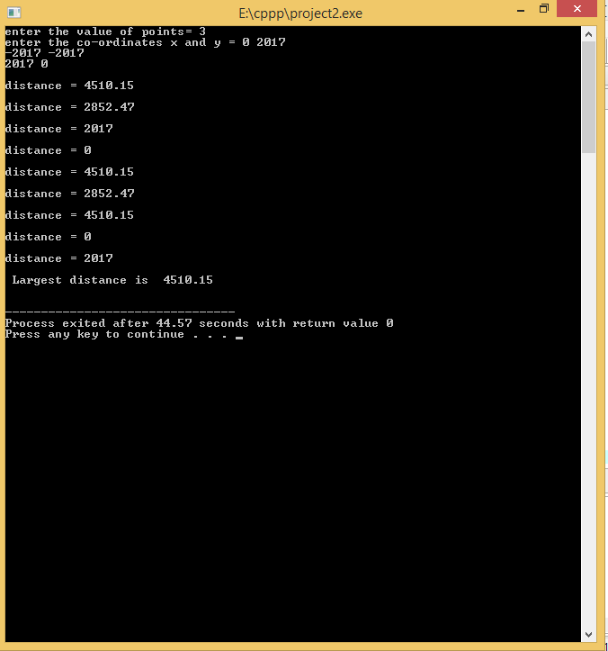
Output
11
Airport Construction

Slide 12
Software/hardware Required
Operating system : Windows OS
Ram : 2GB
Hard disk : 500GB
Airport Construction
12

Slide 13
Conclusion
Polygon shape which is not suitable for airport construction by this mini project it is possible to construct the air track on polygon shape island.
13
Airport Construction

Slide 14
references
ACM ICPC Problem –A 2017
www.acmicpc.com
www.math.com
14
Airport Construction

Slide 15
Thank You…!!!
15
Airport Construction

